Slide 1

Workshop - how do I get from here to there?
let’s now consider how to get a business going
let’s say you have a business idea, a team of people, you’ve decided on a name, you’ve done the branding, designed the logo, got the offices, got brochures for the Ferraris…
that’s all the fun stuff out of the way.
what next?
we expect you to cover this in your 10 Questions

Slide 2
Workshop - how do I get from here to there?
in your 10 Questions, one of the questions asks you to describe your plan for the next 12 months
most business plans project forward 3 or 5 years to give some estimate of sales and income because that’s useful information for investors.
from a planning point of view, it is vital to consider the next 12 months, what steps do you need to undertake to develop your idea further

Slide 3
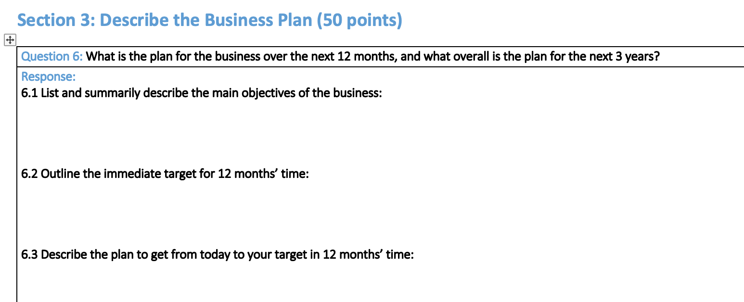
10 Questions

Slide 4
10 Questions
we don’t stipulate what the target at the end of 12 months needs to be
it’s up to you as a team to decide what it is and it depends on what your business idea is
you might be developing an app - so a sensible target might be to have a very good version with a number of users testing it for you
you might be developing a widget - so a sensible target would be to have a working prototype, with the hardware and software being complete

Slide 5
10 Questions
you might be planning a service - so you could say that you’ll have your first 5 customers
what do you feel is achievable in 12 months, and what is necessary?
then discuss and decide what steps you need to undertake each month to get to that target
document these steps ideally in a Gantt chart or simply as coloured blocks on an Excel spreadsheet
the document is an essential part of 10 Questions and can be used in your end of year presentation.

Slide 6
Week number |  |  | 1 |  |  |  |  | 2 |  |  |  |  | 3 |  |  |  |  | 4 |  |  |  |  | 5 |  |  |  |  | 6 |  |  |  |  | 7 |  |  |  |  | 8 |  |  |  |  | 9 |  |  |  |  | 10
Assembly of test system
SBC choice
Assembly
Shopping application
Revised flow chart
Revisions to code
Web page design
Printer support
First-level testing
VMC
Application specific language
Modifications to code
First-level testing
Telemetry
Modifications to format
Price setting from email
PHP code
First-level testing
Testing
Testing in-house
Testing on machine

Slide 7
10 Questions
we want you to think through how you get from today (where you have nothing) to where you need to be in 12 months time
take a service as an example, providing cyber-security services
you need laptops, website, marketing material, training, certification, business suit, transportation, premises - and a handful of customers
how do you acquire all of those and in what sequence? what preparations do you need to make before you can take on clients?

Slide 8
10 Questions
you are building a widget, let’s say it’s a personal body cam to record everything in your day
so you set a target of having 10 prototypes by 12 months time, and some volunteers to test
you need to design hardware (electronics and a housing), design software; do you do this yourselves or recruit experts?
you need to find a manufacturer to build and test
you need to recruit volunteers to help test, you need to build 10 prototypes

Slide 9
Workshop - how do I get from here to there?
get into your teams of a few people
choose an example product
a smartphone app, handling phone calls or text messages intelligently
a new piece of technology, a hardware gadget such as a e-reader for the blind
a service, providing support for women returning to work

Slide 10
Workshop - planning
pick a target for 12 months time
a first prototype
first customer
raised finance
completed an app
there are no rules on this target, it is up to you as a team to decide on this - you might need to justify it
what are the steps you need to take to get a product to market?

Slide 11
Workshop - planning
Your first job - an exercise
let’s take a more personal target
by this time next year, you want to be in your first postgraduate job
what steps do you need to take?
what’s the campaign?
what materials do you need?

Slide 12
Workshop - planning
Manufacturing/production
what are the steps you need to take to get a product to market?
will you need a prototype?
who will design the device?
how will you manufacture?
who will manufacture?

Slide 13
Workshop - planning
Marketing
how will you market your product?
how will you create interest in your product?
how much will you charge?
can you think of an obvious first customer?
how do you plan to find further customers?
who will stock your product?

Slide 14
Workshop - planning
Finance
do you need more money?
where will you get additional money?
how much do you need?
where will you get people to help you, workers, support staff, advisors?

